Slide 1
ONLINE VOTING SYSTEM
Presented By : Apekshya Dhungana and Kalyan G.C

Slide 2
OVERVIEW
Introduction
Requirement analysis
Implementing tools
Problem of statement
Data Modeling
Epilogue
Objectives
Process Modeling
Ending

Slide 3
INTRODUCTION
Online voting is nothing but a secure voting tool that allows voters to cast a vote and view results online.
Online voting system allows voters to cast their votes without their physical presence rather from where they are with their devices connected to the internet.
It is also referred to as I-voting, online election system or online e-voting.

Slide 4

PROBLEM OF STATEMENT
There are lots of drawbacks of both previous and present voting systems that require lots of human resource, time and money.
And mainly it requires lots of paper and paperwork for registration, identification, authentication, etc. Also, there are malpractices in the elections which result in chaos and violence.
Hence, there is a need to replace the current voting system with an online voting system which could overcome the cons of the previous system.

Slide 5
OBJECTIVES
1
To create a secured, accessible digital voting system.
2
To let all the user cast votes.
3
To display real-time vote counts and maintain transparency in voting.

Slide 6
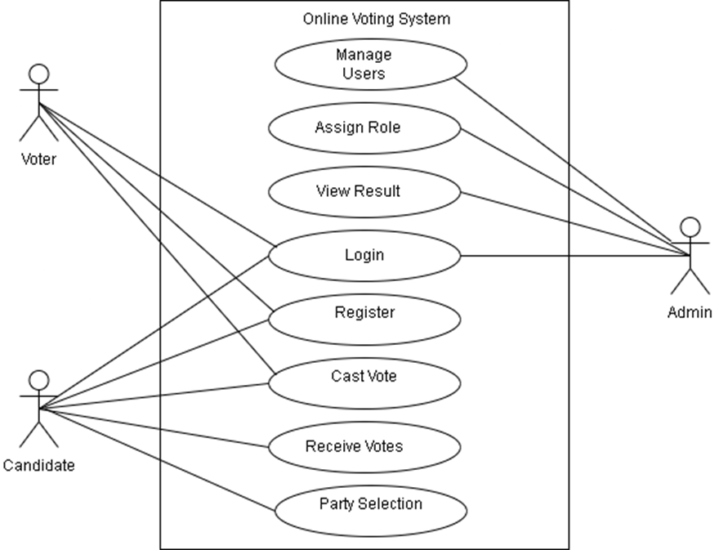
REQUIREMENT ANALYSIS
Functional Requirement
The use case diagram represents the requirement of the system comprising use cases, voters, admin and their relationships. This use case diagram shows functional requirements of the system between admin and the user when registered as a voter. When registered as a voter, he/she can login to cast a vote to the candidate. Candidates can receive votes and select a party. Admin looks after the overall management of the system.

Slide 7
NON FUNCTIONAL REQUIREMENT
Security
Performance
Maintainability
Reliability
Scalability

Slide 8
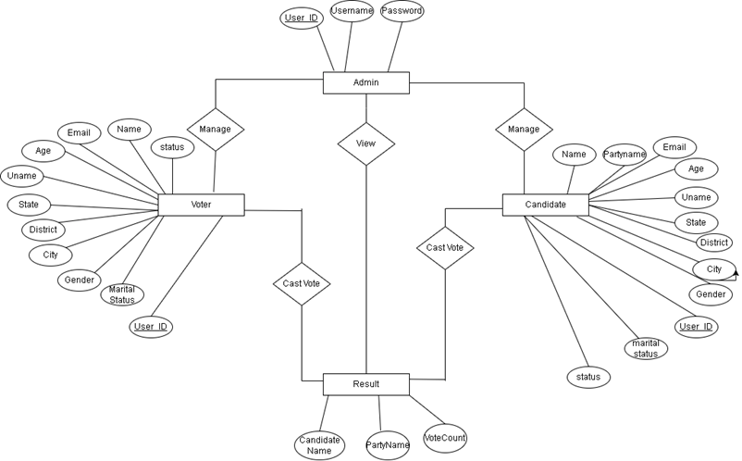
DATA MODELING
This model shows entities, relationships between entities, mapping and the entity relationship models.
User provides all the required information and gets a role. When assigned a voter, he/she can cast a vote.
When assigned a candidate he/she is assigned a party.
Vote count gets the number of casted votes along with party name, voter info and provides it to result which can be viewed by everyone.
Fig: ER DIAGRAM

Slide 9
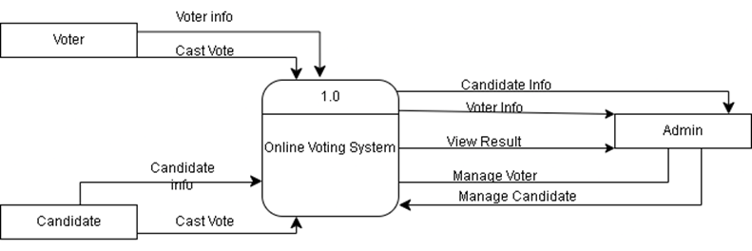
PROCESS MODELING
DFD is an abstract description of the system. DFDs are in levels which represent increasing information flow and functional detail.
User chooses a role either as a voter or a candidate. All the registration votes and voting details are stored in the database.
As the admin manages elections, he/she manages voters and candidate information too. System generates results which can be viewed by admin.
Fig: Context level DFD

Slide 10
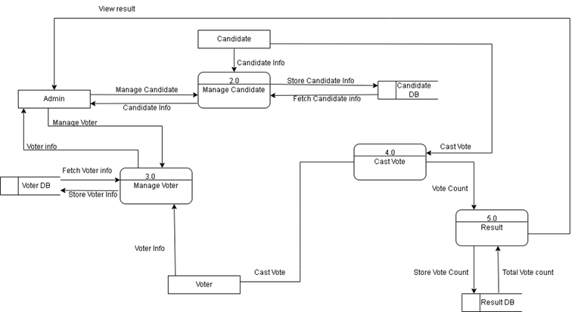
Fig: Level 1 DFD
Users need to register in the system and should provide their information to get a role. Candidates and Voters both can cast votes. Admin manages all users and can view the result too.

Slide 11
IMPLEMENTING TOOLS
Tools Used (CASE tools, Programming languages, Database platforms)
Diagramming tools such as draw.io, lucid chart and dia were used for graphical representation of the data and systems.
These were used to make flowcharts, DFD, ER diagrams, Gantt Charts, etc. MSWord was used for the documentation. Visual Studio Code was used to write, edit and compile the codes.
PHP, JavaScript, CSS, HTML was used to build the webapp. XAMPP was used to host the webapp. MySQL was used to design the database for data storage.

Slide 12
EPILOGUE
The system lets users select roles at the time of registration either as a voter and candidate. Also, all the users both voter and candidate, can cast votes by logging into the system and choosing their favorite candidate. After casting the votes, admin can view the vote counts from the results tab.

Slide 13
THANK YOU
Presented By : Apekshya Dhungana &
Kalyan G.C

